Slide 1
A SMART CHATBOT APPLICATION TO SIMULATE HUMAN TEXT BASED TO SOLVE CUSTOMER PROBLEM
PIP104 PROFESSIONAL PRACTICE-II
VIVA-VOCE
Roll Number | Student Name
20201CAI0091 | RITIK KUMAR SARAOGI
20201CAI0092 | VICKY KUMAR
20201CAI0102 | ARYATEJA
20201CAI0113 | MANN KUMAR
Batch Number: 14
Under the Supervision of,
Dr. Dr.Mohammadi Akheela Khanum
School of Computer Science Engineering & Information Science
Presidency University

Slide 2
Introduction
In today's dynamic digital landscape, the development of a Smart Chatbot Application holds immense significance for my final year engineering project in artificial intelligence and machine learning. This project is a fusion of advanced AI and ML techniques to create a chatbot capable of simulating human-like text-based interactions, a crucial component in modern customer support services.
The primary objective of this project is to design a chatbot that can decipher and resolve customer complaints and queries. To achieve this, we'll leverage natural language processing (NLP) to understand and process customer inputs. The chatbot will then efficiently search through a database to find appropriate solutions. An innovative twist lies in its ability to recognize new, previously undocumented solutions, in which case it deftly hands over the conversation to support staff for resolution.

Slide 3
Introduction
Furthermore, the chatbot's learning capability is a vital aspect of this project. By analyzing interactions between customers and support staff, it continually updates its knowledge base, making it better equipped to tackle similar issues in the future.
This project presents a prime example of AI and ML applications in real-world problem-solving, contributing to efficient customer support and elevating user satisfaction. It's a journey into the practical realm of AI and machine learning, aimed at enhancing human-computer interactions and redefining customer service in the digital age.

Slide 4
Introduction
Inspired by the research papers such as In [1] and In [6], this project aims to create a versatile chatbot that not only enhances customer experience but also adapts to specific user needs.
Through careful consideration of insights from In [3], In [7], and Unsupervised Context Rewriting for Open Domain Conversation, this chatbot will be designed to continuously learn, personalize responses, and navigate open-domain conversations effectively.
Additionally, the project will explore human-chatbot relationships and conduct a longitudinal study, as discussed in [2] and In [4], to ensure that the chatbot offers a user-friendly and efficient interface.
The ultimate goal is to revolutionize customer service by providing an intelligent, adaptable, and context-aware chatbot solution.

Slide 5
Literature Review
In [1]:
- The insights from this paper can help you understand the implications of AI-based chatbots on user compliance, which may be crucial for your project's success.
In [2] and In [4]:
- These papers delve into the dynamics of human-chatbot relationships, which is relevant to designing a chatbot that can simulate human-like interactions, a key aspect of your project.
In [3]:
- This paper can provide valuable guidance on the design principles and systems to be employed in your chatbot development.

Slide 6
Literature Review
In [5]:
- This paper is directly aligned with your project's goal of enhancing customer service efficiency through AI-powered chatbots.
In [6]:
- Though this paper focuses on mental health, it highlights the importance of cognitive skills and personalization, which can be beneficial if you plan to extend your chatbot's capabilities to address customer problems.
In [10]:
- Techniques for unsupervised context rewriting can help ensure that your chatbot's responses are contextually relevant and aligned with user queries in open domain conversations.

Slide 7
Literature Review
In [7]:
- The concept of feedback-based self-learning can be instrumental in improving your chatbot's performance over time, making it more effective in solving customer problems.
In [8]:
- This tool can be a valuable resource for simulating human-like text-based interactions, which is a central aspect of your project.
In [9]:
- Integrating open data sources, as explored in this paper, can enhance your chatbot's knowledge base and ability to provide information to customers.

Slide 8
Literature Review
By considering the insights and methodologies presented in these research papers, you can develop a comprehensive understanding of chatbot design, user interactions, and the strategies required to create an effective Smart Chatbot Application for your final year engineering project.
The Role of Chatbots in Enhancing Customer Experience:
- This paper underscores the significance of chatbots in improving customer experience, which is a primary objective of your project.

Slide 9
Research Gaps Identified
In [1]:
- Potential drawbacks include chatbot misunderstandings, leading to user frustration.
- Limited ability to handle complex or emotionally sensitive customer inquiries.
- Over-reliance on chatbots might negatively impact customer-agent relationships.
In [2]:
- Drawbacks involve chatbots not fully understanding or responding to human emotions.
- Some users may find it challenging to build meaningful connections with chatbots.
In [3]:
- Developing effective chatbots can be complex and require advanced technical knowledge.
- Designing chatbots that engage users and provide valuable interactions is an ongoing challenge.

Slide 10
Research Gaps Identified
In [4]:
- Over time, users may grow tired of interactions with chatbots, impacting user satisfaction.
- Chatbots may not adapt well to changes in user preferences and expectations.
In [5]:
- Chatbots may not handle all customer service inquiries, necessitating human intervention.
- User resistance to AI-driven customer service may hinder adoption.
In [6]:
- Users may have concerns about sharing sensitive mental health information with a chatbot.
- Chatbots may not be suitable for severe mental health conditions that require immediate human intervention.

Slide 11
Research Gaps Identified
In [7]:
- Dependence on user feedback for improvement may result in slow progress in chatbot performance.
- Difficulty in collecting sufficient high-quality feedback for training purposes.
In [8]:
- The tool's usability may vary based on user technical proficiency.
- Simulated interactions might not fully represent real-world chatbot use cases.
In [9]:
- Chatbot accuracy in providing open data information could be limited by data quality.
- Challenges in training chatbots to understand and respond to diverse user queries.

Slide 12
Research Gaps Identified
In [7]:
- Dependence on user feedback for improvement may result in slow progress in chatbot performance.
- Difficulty in collecting sufficient high-quality feedback for training purposes.
In [8]:
- The tool's usability may vary based on user technical proficiency.
- Simulated interactions might not fully represent real-world chatbot use cases.
In [9]:
- Chatbot accuracy in providing open data information could be limited by data quality.
- Challenges in training chatbots to understand and respond to diverse user queries.

Slide 13
Proposed Methodology
1. Data Collection and Preprocessing
2. Natural Language Processing (NLP)
3. Knowledge Base Development
4. Search and Matching Algorithm
5. Solution Recognition
6. Handover Mechanism
7. Learning and Adaptation
8. Continuous Improvement
9. Security and Privacy
10. Multichannel Support and Scalability

Slide 14
Objectives
Reduce Support Staff Workload
Feedback Integration
Ranking Queries In The Chat Bot
Update Database

Slide 15
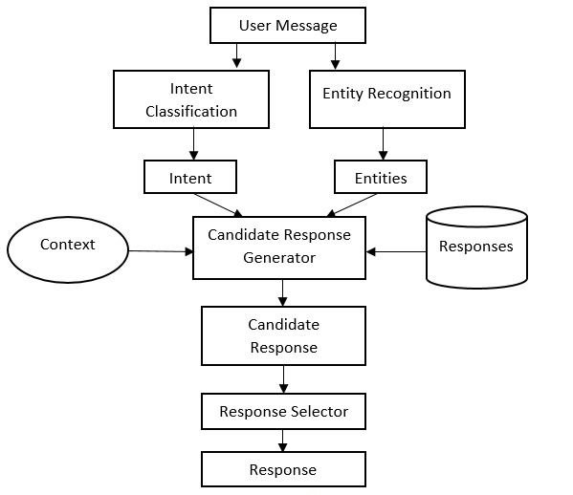
Architecture Design & Implementation

Slide 16
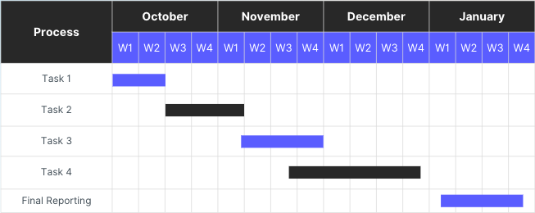
Timeline of Project(GANTT CHART)

Slide 17
Outcomes / Results Obtained
REDUCED WORKLOAD
EFFICIENT SOLUTIONS PROVIDED
FEED BACK INTEGRATED

Slide 18
Conclusion
The inclusion of Chat-Bot-Kit as a tool to simulate text-based interactions has facilitated the practical development of our chatbot. In [9] suggests the advantages of integrating open data sources to enrich the chatbot's knowledge base, while Unsupervised Context Rewriting for Open Domain Conversation underscores the importance of context-aware responses.
In summary, this project amalgamates the wisdom from these research papers to create a versatile and intelligent chatbot capable of simulating human text-based interaction to effectively solve customer problems and significantly enhance customer experience in various domains.
Paper [9] could help us enhance the chatbot's knowledge base, while [10] could aid in making responses more coherent. [8] is a practical tool for testing and training your chatbot, and [7] offers insights on how to continuously improve the chatbot's performance through user feedback. Incorporating these concepts and tools into the project can help make our chatbot smarter and more user-friendly, ultimately contributing to its effectiveness in solving customer problems through natural text-based interactions.

Slide 19
Conclusion
The aspiration to increase customer service efficiency through AI chatbots, as outlined in In [5], is at the heart of our project's goals. In [6] has highlighted the potential for cognitive skills and personalization in customer problem-solving.
The inclusion of Chat-Bot-Kit as a tool to simulate text-based interactions has facilitated the practical development of our chatbot. In [9] suggests the advantages of integrating open data sources to enrich the chatbot's knowledge base, while Unsupervised Context Rewriting for Open Domain Conversation underscores the importance of context-aware responses.
In summary, this project amalgamates the wisdom from these research papers to create a versatile and intelligent chatbot capable of simulating human text-based interaction to effectively solve customer problems and significantly enhance customer experience in various domains.
Paper [9] could help us enhance the chatbot's knowledge base, while [10] could aid in making responses more coherent. [8] is a practical tool for testing and training your chatbot, and [7] offers insights on how to continuously improve the chatbot's performance through user feedback. Incorporating these concepts and tools into the project can help make our chatbot smarter and more user-friendly, ultimately contributing to its effectiveness in solving customer problems through natural text-based interactions.

Slide 20
References
[1] Adam, M., Wessel, M., & Benlian, A. (2021). AI-based chatbots in customer service and their effects on user compliance. Electronic Markets, 31(2), 427-445.
[2] Skjuve, M., Følstad, A., Fostervold, K. I., & Brandtzaeg, P. B. (2021). My chatbot companion-a study of human-chatbot relationships. International Journal of Human-Computer Studies, 149, 102601.
[3] Feine, J., Morana, S., & Maedche, A. (2020). Designing Interactive Chatbot Development Systems. In ICIS.
[4] Følstad, A., Fostervold, K. I., & Brandtzæg, P. B. (2022). A longitudinal study of human–chatbot relationships. International Journal of Human-Computer Studies, 168.
[5] De Andrade, I. M., & Tumelero, C. (2022). Increasing customer service efficiency through artificial intelligence chatbot. Revista de Gestão, 29(3), 238-251.

Slide 21
References
[6] Rathnayaka Mudiyanselage, P. M., Mills, N., Burnett, D., De Silva, D., Alahakoon, D., & Gray, R. (2022). A Mental Health Chatbot with Cognitive Skills for Personalised Behavioural Activation and Remote Health Monitoring.
[7] Ponnusamy, P., Ghias, A., Yi, Y., Yao, B., Guo, C., & Sarikaya, R. (2022). Feedback-based self-learning in large-scale conversational ai agents. AI magazine, 42(4), 43-56.
[8] Sugisaki, K. (2019). Chat-Bot-Kit: A web-based tool to simulate text-based interactions between humans and with computers. arXiv preprint arXiv:1911.00665.
[9] Keyner, S., Savenkov, V., & Vakulenko, S. (2019). Open data chatbot. In The Semantic Web: ESWC 2019 Satellite Events: ESWC 2019 Satellite Events, Portorož, Slovenia, June 2–6, 2019, Revised Selected Papers 16 (pp. 111-115). Springer International Publishing.
[10] Zhou, K., Zhang, K., Wu, Y., Liu, S., & Yu, J. (2019). Unsupervised context rewriting for open domain conversation. arXiv preprint arXiv:1910.08282.

Slide 22
Publication Details
Under Review

Slide 23

Thank You

